Slide 1
Enterprise Systems
Chap # 11&12

Slide 2
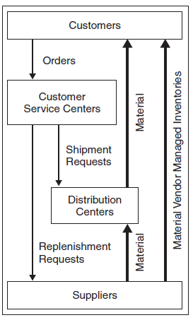
SUPPLY CHAIN MANAGEMENT
Supply chain management “encompasses the planning and management of all activities involved in sourcing and procurement, conversion, and all logistics management activities. It also includes coordination and collaboration with channel partners. In essence, supply chain management integrates supply and demand management within and across companies.”
For any company to be successful , its supply chain strategy and competitive strategy must be aligned or work together toward a common goal.

Slide 3
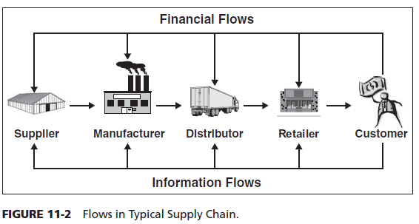
SCM Flows
SCM flows can be divided into three main categories: product flow, information flow, and finance flow.
• The product flow includes the movement of goods from a supplier to a customer, as well as any customer returns or service needs.
• The information flow involves transmitting orders and updating the status of delivery.
• The financial flow consists of credit terms, payment schedules, and consignment and title ownership arrangements.

Slide 4
E-Procurement
E-procurement is the use of Web-based technology to support the key procurement processes, including requisitions, sourcing, contracting, ordering, and payment. The use of e-procurement has many benefits.
FORECASTING
Forecasting seeks to predict levels of weekly or monthly product activity over a time horizon. The statistical methods proven to make such predictions have been used by manufacturers and distributors. A failure to consolidate the forecasting information along the supply chain will result in bullwhip effect.
REPLENISHMENT SYSTEMS
Supply chain replenishment encompasses the integrated production and distribution process. Its well-known drug store chain, almost completely relies on its e-SCM system to reduce inventory levels as well as to eliminate stocking points.

Slide 5
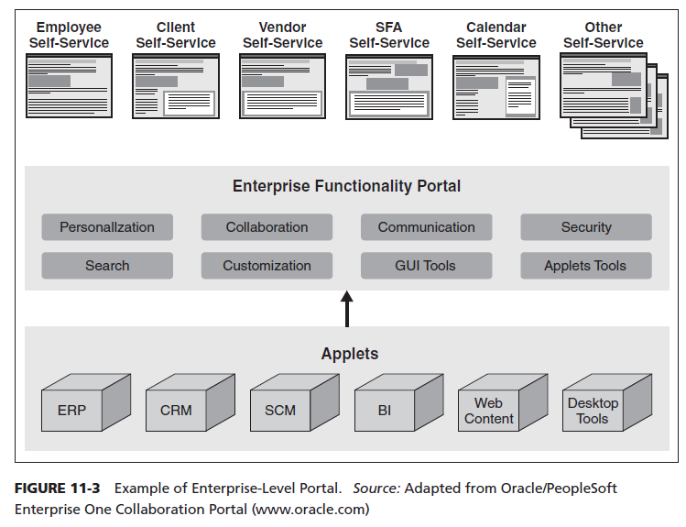
Enterprise Level Portal

Slide 6
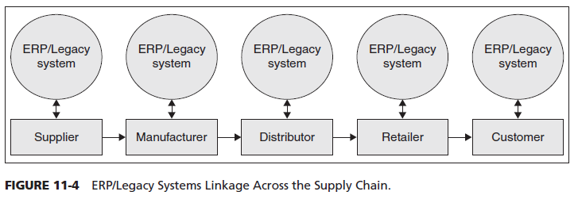
ERP/Legacy Systems Linkage

Slide 7
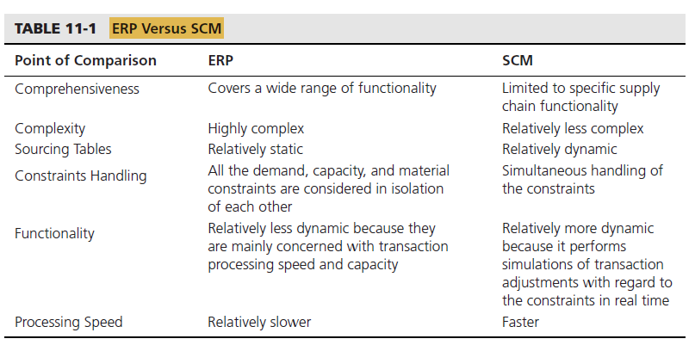
ERP Versus SCM

Slide 8
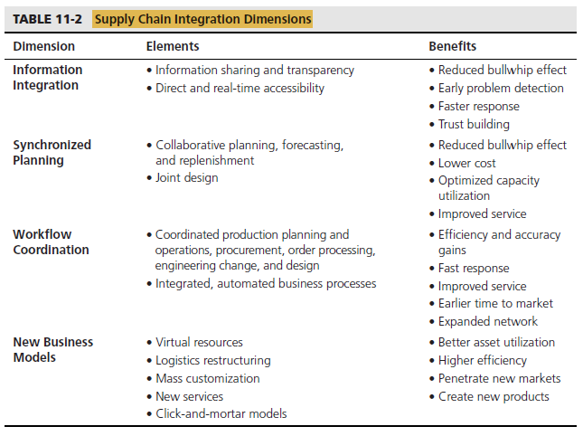
SCM Integration Dimensions

Slide 9
Phases of Enterprise Application Integration Process
Enterprise application integration (EAI) facilitates the flow of information and straps transactions among disparate and complex applications and business processes within and among the organizations.
There are several phases of an EAI process, including the following:
• Solution outline phase
• Architecture phase
• Design phase
• Implementation phase
Benefits of Enterprise Application Integration
Increased efficiency
Value of information
Lower costs
Increased productivity
Improved customer service
Enhanced access

Slide 10
RFID
Radio Frequency IDentification, or RFID, has been around since the 1950s. RFID is a small microchip (or tag as it is commonly referred to) that sends/receives data via radio waves sent on specific frequencies. Wal-Mart is a primary reason why this technology is beginning to realize its real value.
With a human doing the operational steps of collecting and entering data, you have a minimum of three places an error and/or retardation of the data can occur:
1. Physical counting of the data
2. Writing down of the data collected
3. Typing the data into ERP
Changing any process where these steps occur to automated RFID data collection will eliminate the possibility of human error.

Slide 11
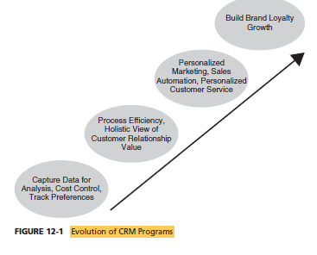
WHAT IS CRM?
A true CRM integrates corporate strategy, business methodology, and technology to accomplish a myriad of goals for companies that want to operate in a customer-driven environment. It also solves the problem during peak loads.
Even though the ERP system focus is more on providing systems support for employees and business partners of an organization, the CRM system focus is on supporting the requirements of customers and clients of the organization.

Slide 12
Types of CRM
OPERATIONAL CRM
Operational CRM systems provide front- and back-end support for sales and marketing, administrative personnel, or customer service processes. They are integrated with the corporate databases to provide a single and consistent view of the customer from anywhere in the organization.
ANALYTICAL CRM
Analytical CRM systems provide tools for collection and analysis of data gathered during the operational process to help create a better relationship and experience with clients or end users. Analytical CRMs utilize sophisticated data warehousing, OLAP, and data mining software for planning, monitoring, and analyzing business activities and to support business intelligence needs.
COLLABORATIVE CRM
Collaborative CRM systems deal with the interaction points between the organization and the customer. To facilitate open and effective communication with the variety of customers with a multitude of preferences. Integrated CRM portal that provides a gateway for customers to access information and to interact electronically with the company.

Slide 13
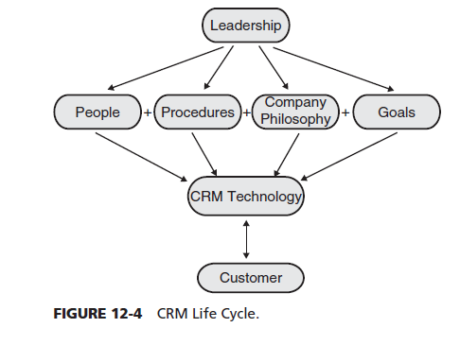
Life Cycle

Slide 14
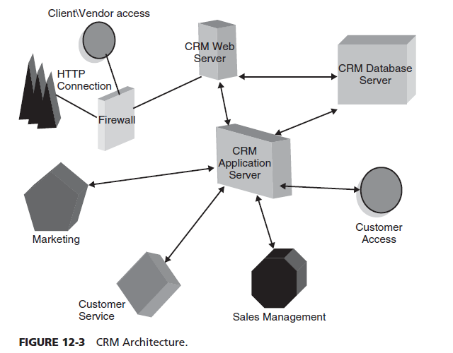
CRM Architecture
The system environment
would consist of the following components:
• Application server: runs either front-end processing or querying data and possibly a Web
interface for the CRM system.
• Database server: houses the back-end database and possibly retrieves information from
other database systems in the company to present through the application server.
• Web server: used if the CRM provides an extranet access point for such external users as
vendors or customers and an intranet access point for employees.

Slide 15
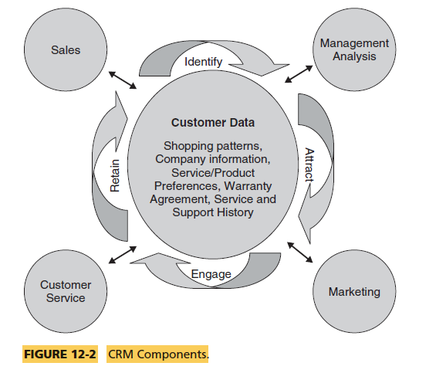
CRM Components

